Slide 1
TELCOs Leverage Data Warehousing
Case Study

Slide 2
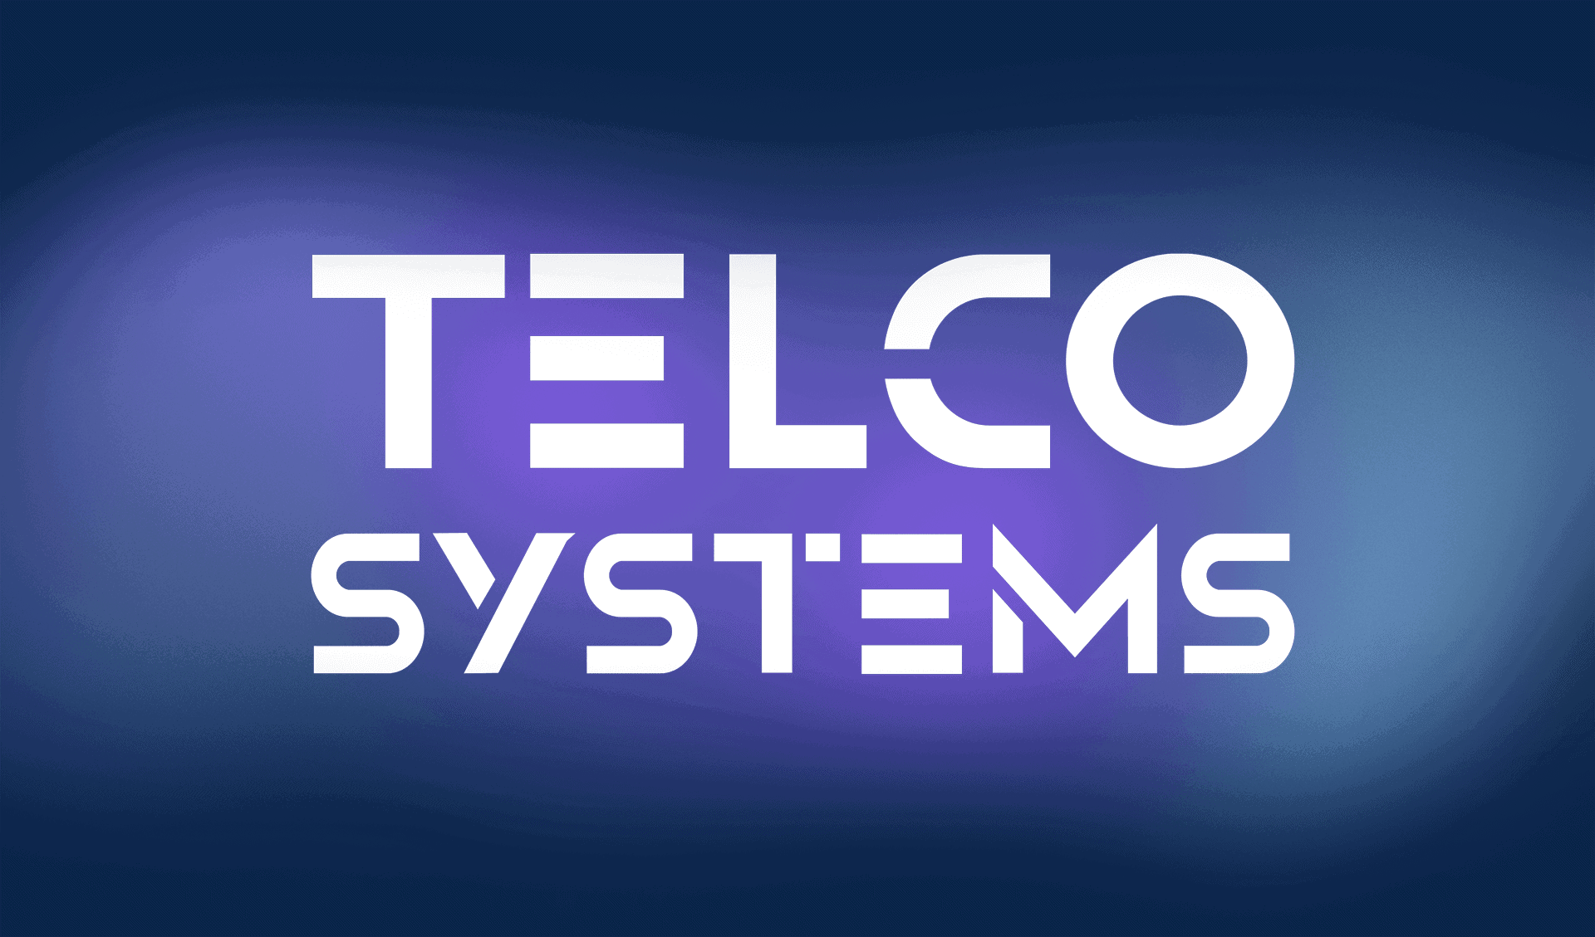

Slide 3
Telco Systems is a manufacturer of telecommunications equipment. It was founded in 1972 and has its headquarters in Mansfield, Massachusetts. Telco Systems solutions focuses around four primary vertical markets - carrier cloud networking and cloud services, business Ethernet services, mobile backhaul^{[1]} and AdvancedTCA (ATCA) switching blades

Slide 4
What are the main challenges for TELCOs?
TELCOs should persistently refine everything from client administration to arrange estimating. The real difficulties confronted by both settled in and new organizations in this industry include: retaining clients, diminishing costs, calibrating valuing models, enhancing consumer loyalty, procuring new clients, and comprehension the part of online networking in loyalty of customers.

Slide 5
How can data warehousing and data analytics help TELCOs in overcoming their challenges?
The organization can without much of a stretch follow the steps included with every procedure to comprehend purposes of disappointment and increasing speed. Through information warehousing and information investigation, the organization can enhance the general fulfillment with on boarding new clients (Sharda, Delen & Turban, 2013). On the other hand

Slide 6
Why do you think TELCOs are well suited to take full advantage of data analytics
TELCOs control the information transfers infrastructure, and secure much utilization information therefore. They have the specialized aptitude to make, convey, and refine arrangements to address their business challenges. The business and versatile innovation have extended and enhanced throughout the years

Slide 7


